Slide 1
An international standardisation effort in technical validation of photoacoustic imaging
Presented by Sarah Bohndiek
on behalf of IPASC
www.ipasc.science

Slide 2

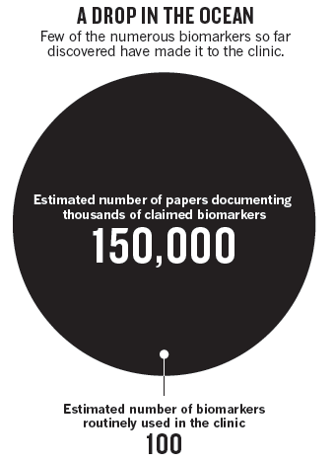
Why should we care about photoacoustic standardisation?
A biomarker is: ‘a defined characteristic that is measured as an indicator of normal biological processes, pathogenic processes or responses to an exposure or intervention, including therapeutic interventions’
Examples of photoacoustic biomarkers include:
Total haemoglobin concentration [mM]
Haemoglobin oxygen saturation (%)
Dynamic contrast enhancement in indocyanine green signal (∆ICG)
http://www.ncbi.nlm.nih.gov/books/NBK326791; Poste (2011) Nature
Notes:
Photoacoustic imaging is now poised for clinical translation, with
multiple completed clinical trials across a range of diseases, particularly oncology,
commercial clinical instruments available,
and filings underway for FDA approval and CE marking

Slide 3
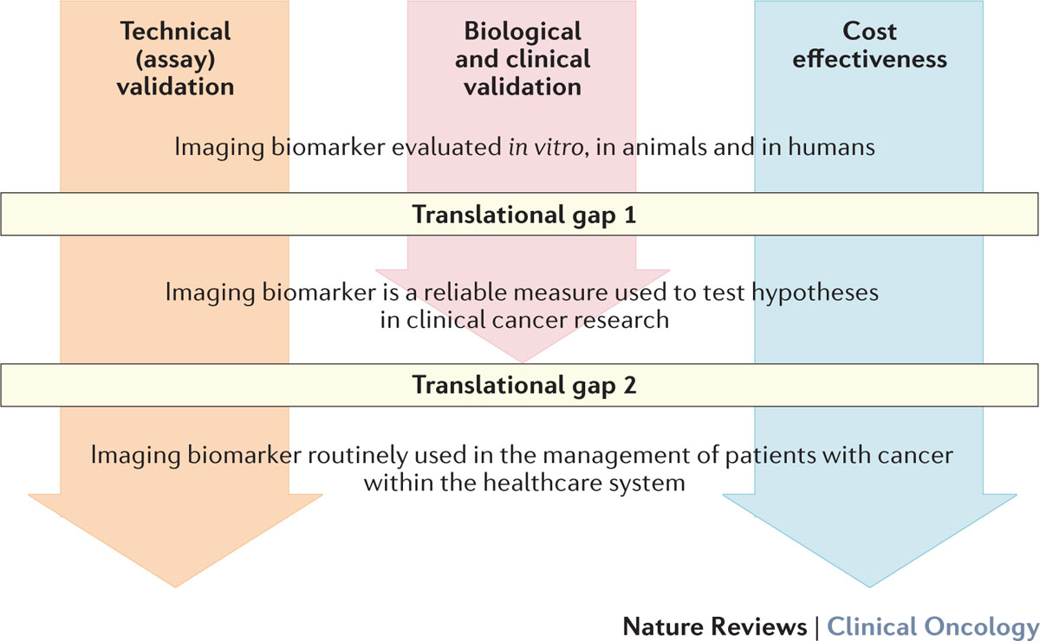
O’Connor et al (2017) Nat Rev Clin Onc 14 3 169-186
Notes:
Technical Aim: Ensure imaging biomarker workflow is robustly available anywhere it is needed, giving comparable results
Precision: Repeatability (same subject, same scanner, same operator, short interval) and reproducibility (comparable subjects, different scanner make/model, centres).
Accuracy: Faithful recapitulation of the expected signal.
Availability: Including considerations of:
legal/IP impediment;
ethical impediment.
Tolerability: For patients and clinicians.
Precision: laser excitation e.g. energy output, acoustic detection e.g. ultrasound coupling, physiology e.g. respiration rate, data handling e.g. image reconstruction method
Accuracy: data handling e.g. image reconstruction method, spectral analysis method
Availability: regulatory approvals of device, licenses for software on remote computers
Model systems: phantoms, mice
Types of measurements: repeated measurements over time (days, weeks, months), repeated measurements in the same subject and in different subjects, across different systems
Biology Aim: Ensure imaging biomarker reflects the biology
E.g. therapy-induced change in imaging biomarker faithfully reflects therapy-induced change in underlying pathology.
Clinical Aim: Ensure imaging biomarker forecasts patient outcome
E.g. imaging biomarker (plus clinical status) improves forecast of outcome, compared with forecast based on clinical status alone
Use Bradford Hill criteria where you haven’t (yet) got decent outcome data

Slide 4
The aims of IPASC are:
To create widely accepted phantoms for use with preclinical and clinical photoacoustic imaging systems.
To use these phantoms in a quantitative comparison of photoacoustic data:
Acquired with different system designs;
Analysed with different data reconstruction / spectral processing algorithms.
To have a reference standard for new photoacoustic imaging instruments (to help with comparison of published results).
To provide open, publicly available, reference data sets for testing of data reconstruction / spectral processing algorithms.

Slide 5
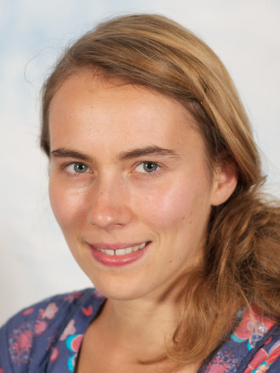
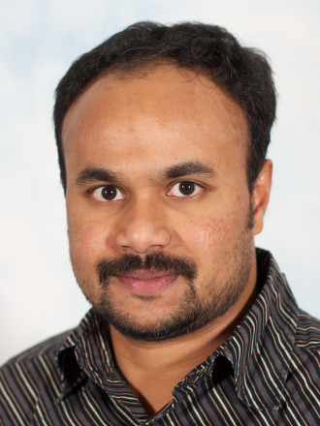
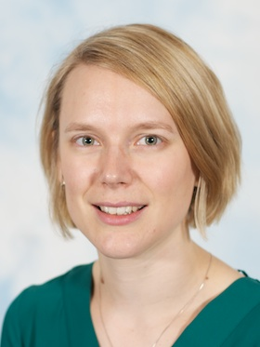
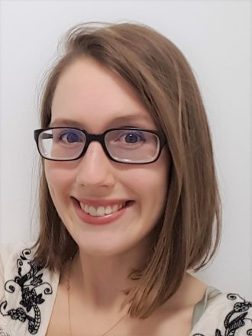
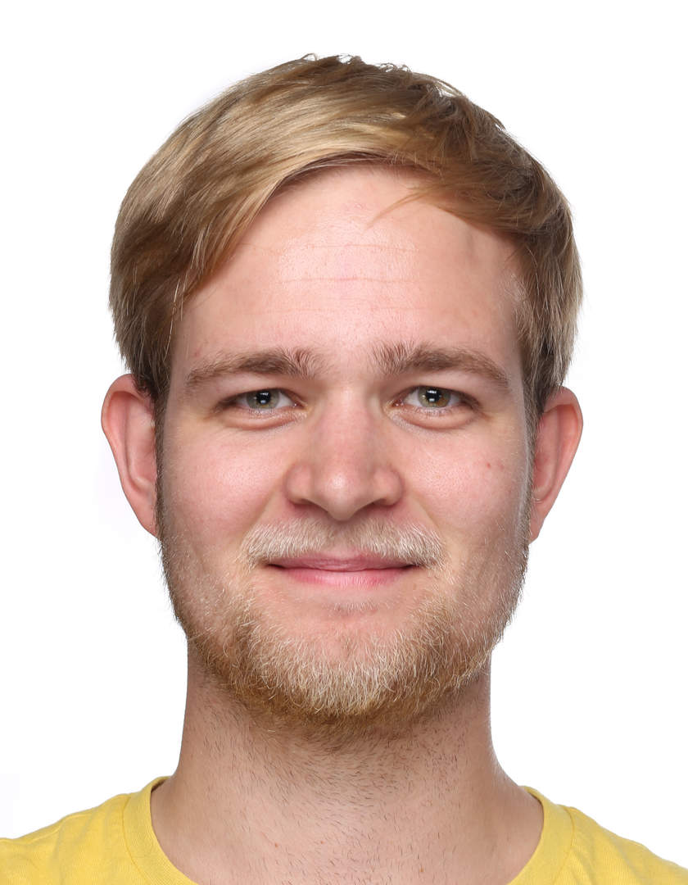
Current IPASC Leadership
Joanna Brunker
(WG1&2 lead)
James Joseph
(WG1&2 lead)
Lina Hacker
(WG3 lead)
Janek Groehl
(WG4 lead)
Sarah Bohndiek
(Chair)
Bill Vogt
(Co-Chair, WG5 lead)
5

Slide 6
Current IPASC Engagement
Europe
Austria
Belgium
Germany
Italy
Netherlands
Switzerland
United Kingdom
1
1
8
4
2
2
14
Academia
41
Asia
Japan
China
Singapore
2
1
1
Industry
8
Canada
United States of America
Americas
3
10

Slide 7
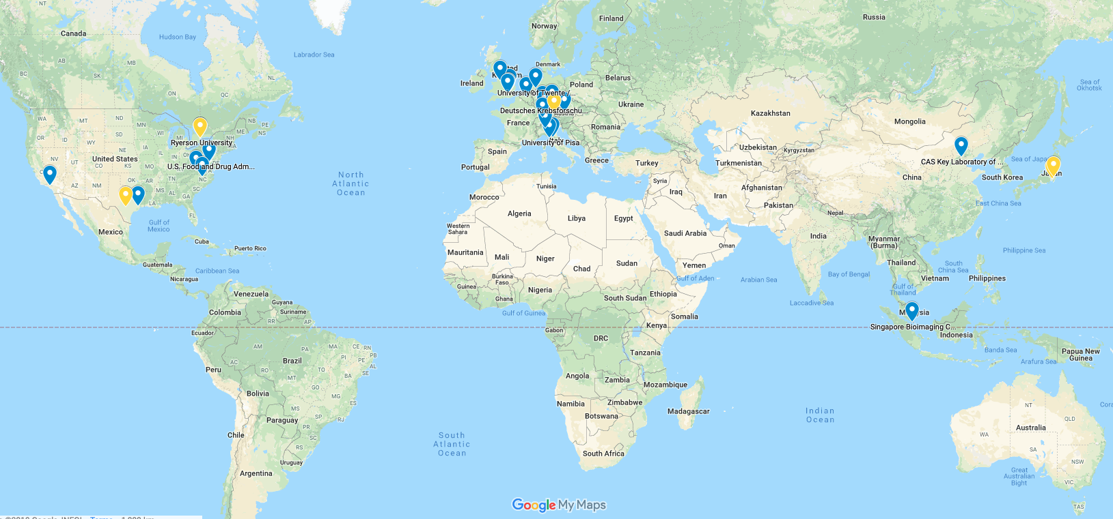
Current IPASC Engagement
Academia
41
Industry
8
Notes:
It’s your consortium

Slide 8
5 IPASC working groups reported back in May 2018
Optical and Acoustic Properties
Optical properties of background
μ_{a (800 nm)}: 0.1 cm⁻¹ μ_{s(800 nm)}’: 10 cm⁻¹
Key wavelengths for targets
750, 800, 850, 1064 nm
Speed of sound
Close to the ultrasound standard of
1540 ms⁻¹
Candidate materials
PVCP, Gel Wax
Materials
Define optical and acoustic properties required for different phantom types
Define geometric phantom designs for QA/QC.
Define the materials to be used for fabrication.
-> Design prototype phantoms

Slide 9
5 IPASC working groups reported back in May 2018
Equipment
Collated commercial and custom-built systems
IPASC members cover macroscopic, mesoscopic, and microscopic imaging
Wavelength range for first studies:
680-1064 nm
Centre frequencies for first studies:
4-40 MHz
Record specifications of home built and commercial PAI systems available within consortium labs
-> Define pilot phantom geometries

Slide 10
5 IPASC working groups reported back in May 2018
Data
Raw time series data required
HDF5 identified as a standardized format
Standardized list of meta data parameters to be agreed
Understand the format of the raw and reconstructed data and metadata
Enable open access
-> Agree metadata to be captured

Slide 11
5 IPASC working groups reported back in May 2018
Clear need to establish agreed guidelines in study design and parameter definitions for PAI quality
Cambridge as source site
‘Test-Ship-Test’ needed - Source site performs QC
Methodology
Develop study designs
Resolve logistical challenges in multi-centre studies
-> Agree image quality metrics to be extracted

Slide 12
Cambridge
SBIC, Singapore
Virginia Tech-Wake Forest, USA
CAS, China
ETH, Switzerland
iThera Medical, Germany
UK-Erlangen, Germany
ICR, UK
UT Southwestern, USA
A first IPASC pilot study has been conducted among commercial MSOT users with Cambridge as the source site

Slide 13
The immediate next steps for IPASC are:
Complete review of the pilot study protocol and data, including phantom properties.
Agree plans for the first full multi-centre study, including several system / phantom geometries and properties.
Conduct first full multi-centre study and write up the findings together with working group conclusions for open access publication.
Launch open access data repository for the pilot study and multi-centre study data.
Secure funding for the consortium.
We also welcome YOUR suggestions during the panel discussion!
Notes:
Any suggestions for funders?

Slide 14
Acknowledgements
DISCLAIMER: The mention of commercial products, their sources, or their use in connection with material reported herein is not to be construed as either an actual or implied endorsement of such products by the Department of Health and Human Services.
Working Group Leads
Joanna Brunker UK
James Joseph UK
Lina Hacker UK
Janek Grohl Germany
William Vogt USA
Chair - Sarah Bohndiek UK Co-Chair - William Vogt USA
Academic Members
Paolo Armanetti Italy
Hisham Assi Canada
Jeff Bamber UK
Paul Beard UK
Thomas Berer Austria
Richard Bouchard USA
Kimberly Briggman USA
Lucia Cavigli Italy
Ben Cox UK
Adrien Desjardins UK
Jeeseong Hwang USA
Eno Hysi Canada
Aoife Ivory UK
Academic Members
Thomas Kirchner Germany
Jan Klohs Switzerland
Lena Maier-Hein Germany
Efthymios Maneas UK
Julia Mannheim Germany
Srirang Manohar Netherlands
Lacey McNally USA
Luca Menichetti Italy
Ruiqing Ni Switzerland
Malini Olivo Singapore
Marty Pagel USA
Geoff Parker UK
Anna Pelagotti Belgium
Academic Members
Antonio Pifferi Italy
Srinath Rajagopal UK
Daniel Razansky Germany
Avihai Ron Germany
Maximillian Waldner
Germany
Kun Wang China
Lihong Wang USA
Wenfeng Xia UK
Bajram Zeqiri UK
Industrial Members
Bryan Clingman USA
Drew Heinmiller Canada
Jithin Jose Netherlands
Steven Miller USA
Stefan Morscher Germany
Yoko Okamura Japan
Lisa Richards USA
Mithun Singh Japan
To find out more, please visit: www.ipasc.science

Slide 15
IPASC 1st Networking and Social Event
5pm to 8pm this evening
Wine Down SF
https://www.winedownsf.com/
Complimentary drinks & snacks provided
All welcome!

